Slide 1
The Coding Bootcamp: Day 0

Slide 2
Before We Begin...
Just a few notes about Zoom before we begin...

Slide 3
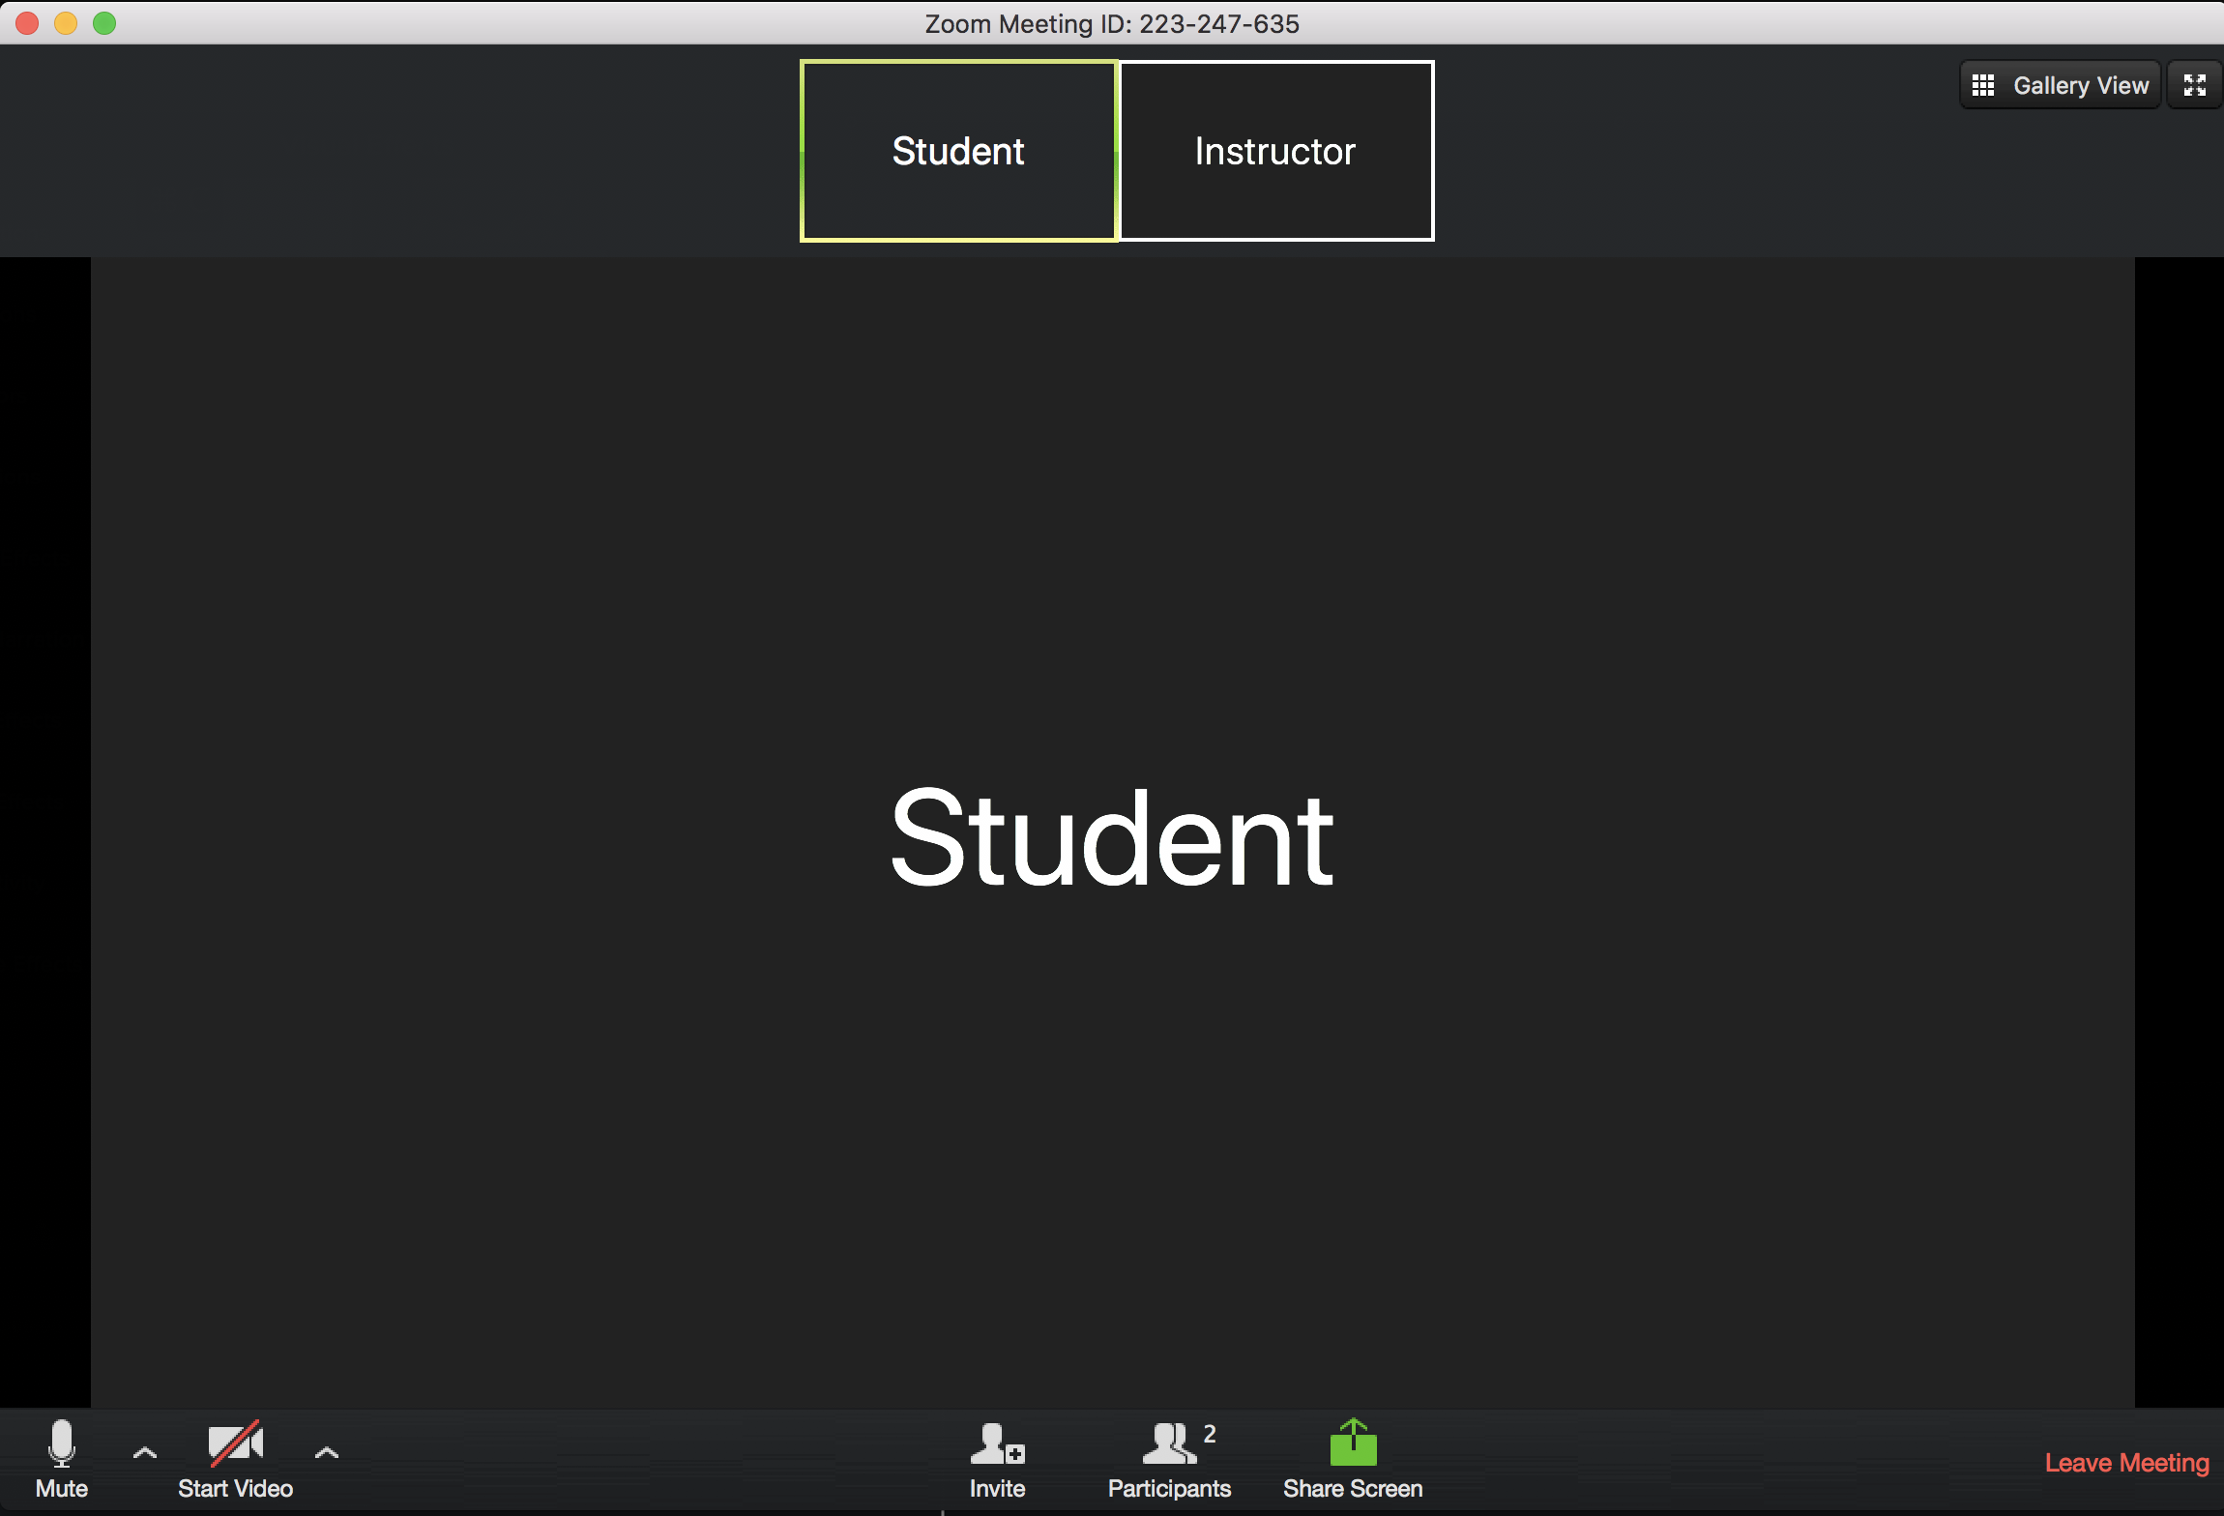
User Controls are located at the bottom of your Zoom

Slide 4
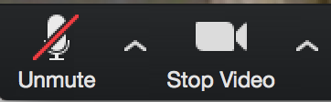
Microphone and Camera Settings
Mute yourself unless you’re speaking
Leave video on during class so the instructor can see you!
Notes:
Have students mute themselves and their videos on!

Slide 5
Participant Window & Raise Hand
Click “Participants” button to open menu, you’ll see a “Raise Hand” button here
You can also “Lower Hand” after raising in this menu
Notes:
Have students all raise their hands then lower them!

Slide 6
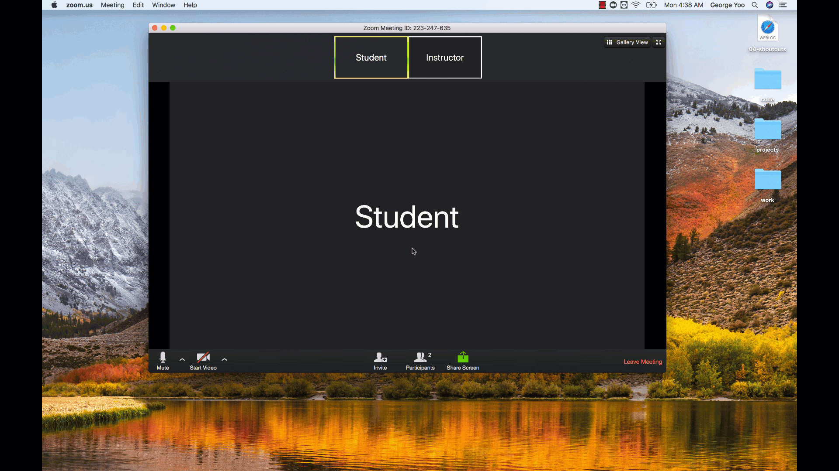
Participant Window & Raise Hand

Slide 7

Let’s Begin!
Now that we have that out of the way...
On with the show!

Slide 8

Quick Introductions (30 Seconds)
Name
Location
Background (Career, Education, Interests)
Why learn web development?
Excited about class?

Slide 9

Instructor = …?
Your Name Here
<insert education or experience tidbit>
<insert education or experience tidbit>
Over <#> years coding, (with plenty of experience being a n00b at it.)
<personal fact>
Secretly, a <funny fact about yourself>

Slide 10

Some Cool Stuff I Made...

Slide 11
Online Class Schedule

Slide 12
Online Class
Weekday
Office Hours: 5:45pm - 6:30pm
Class: 6:30pm - 9:30pm
Office Hours: 9:30pm - 10pm

Slide 13
Online Class
Weekend
Office Hours: 9:15am - 10:00am
Class: 10:00am - 2:00pm
Office Hours: 2:00pm - 2:30pm

Slide 14
Online Class
Office hours and class will be hosted on Zoom!

Slide 15
Tools for Fools

Slide 16
Online Class
Slack
Zoom
Visual Studio Code

Slide 17
Slack Desktop Client

Slide 18
Slack Desktop Client
Everyone take a moment to download the Slack Desktop App if you haven’t already!
https://slack.com/downloads/

Slide 19
Slack

Slide 20
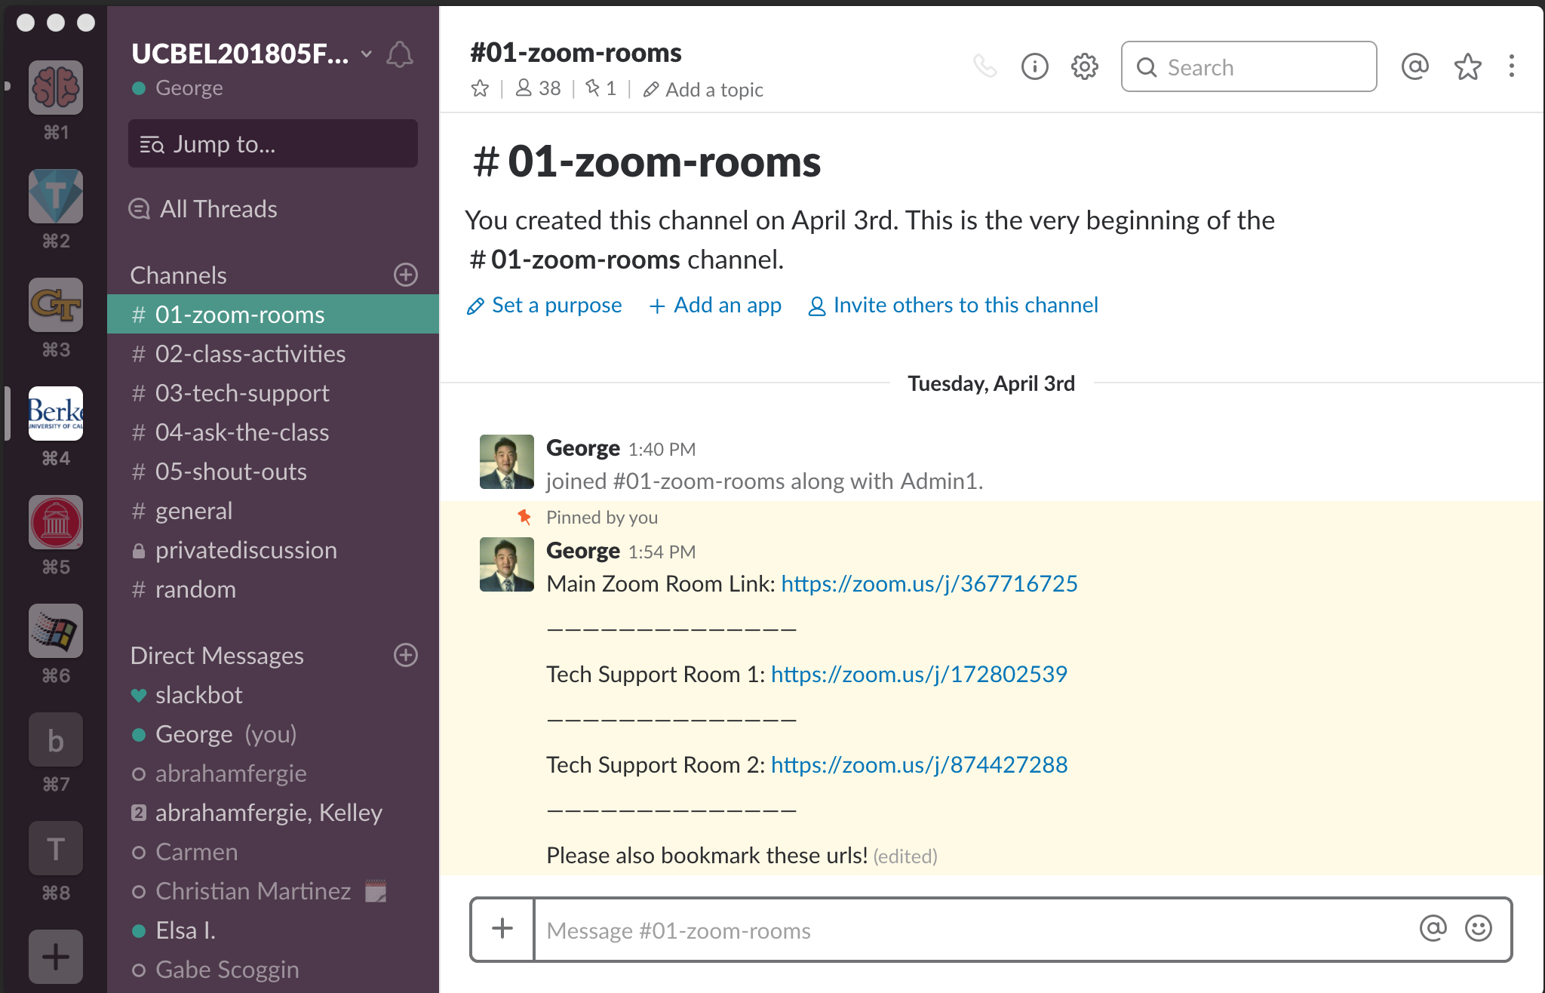
Slack Channels
#01-zoom-rooms

Slide 21
#01-zoom-rooms
Links for Online Class:
Main Room
Tech Support Room

Slide 22
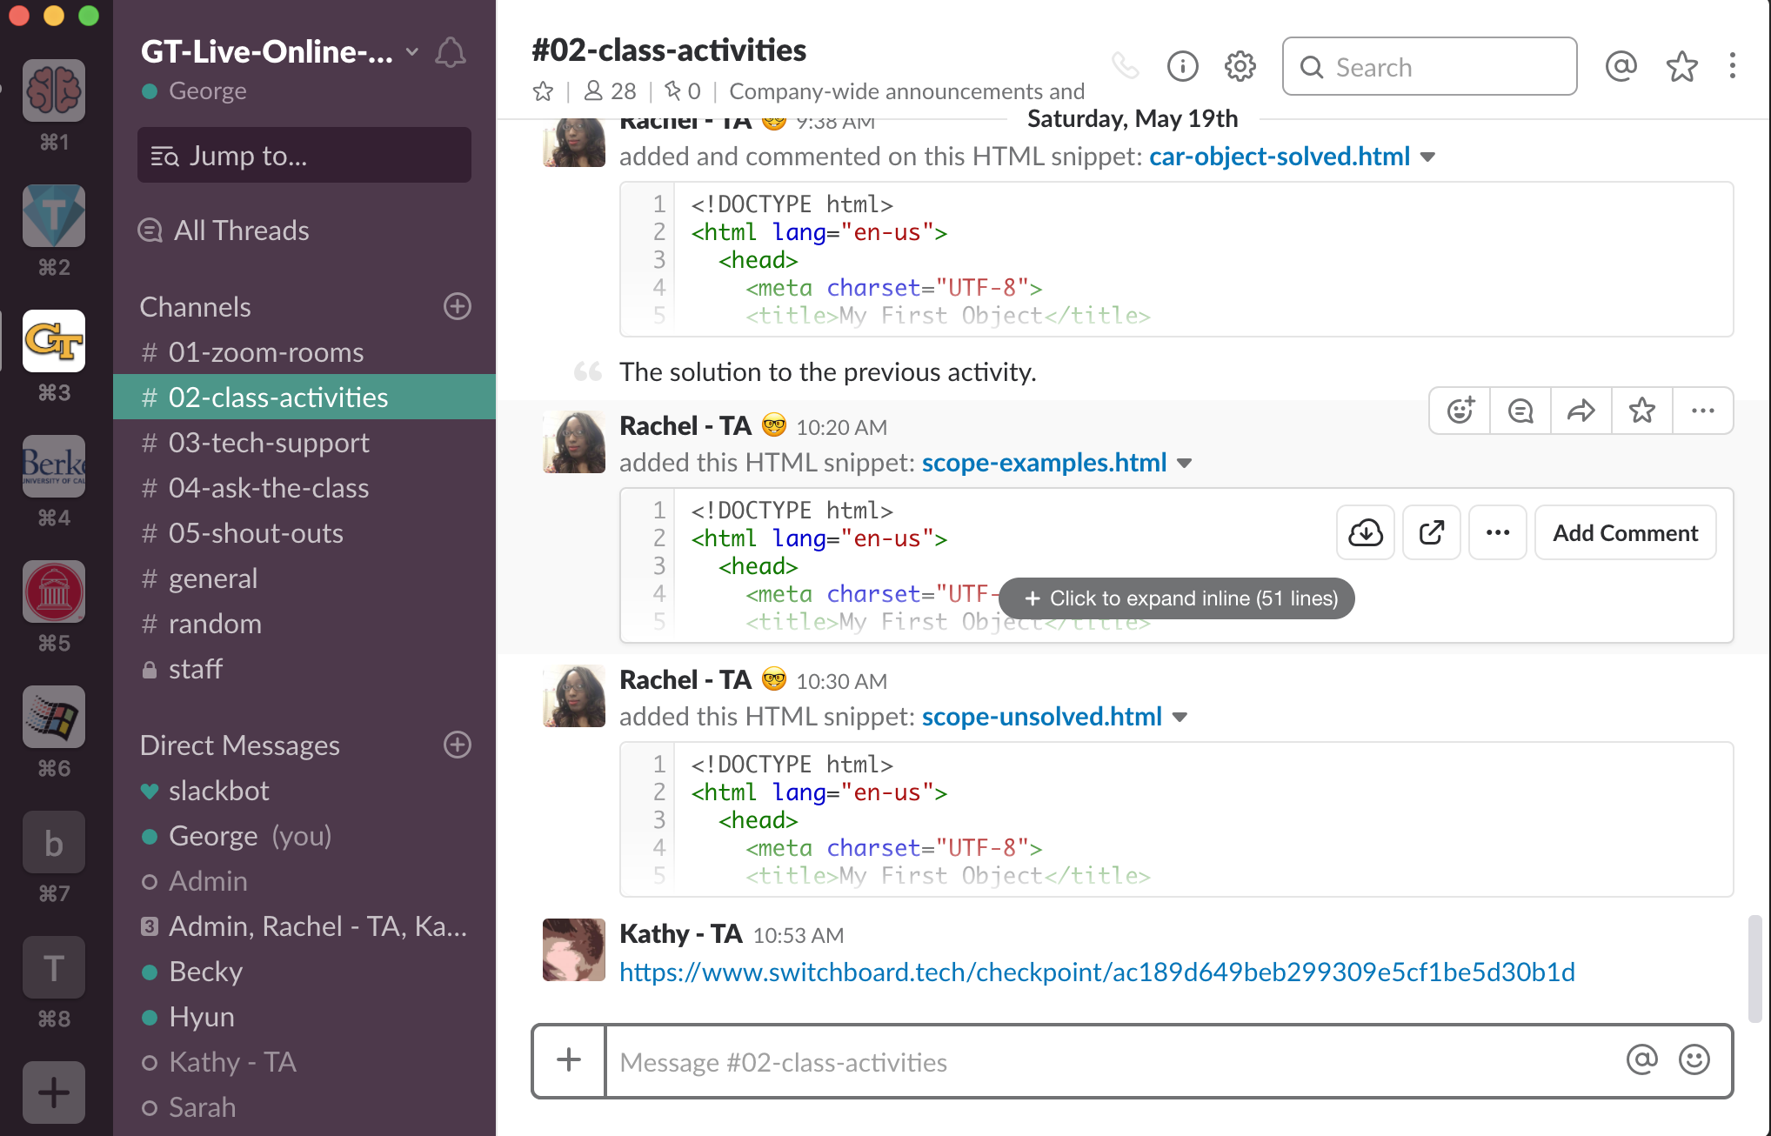
Slack Channels
#02-class-activities

Slide 23
#02-class-activities
Activity files you’ll work on during class will be posted in #02-class-activities.

Slide 24
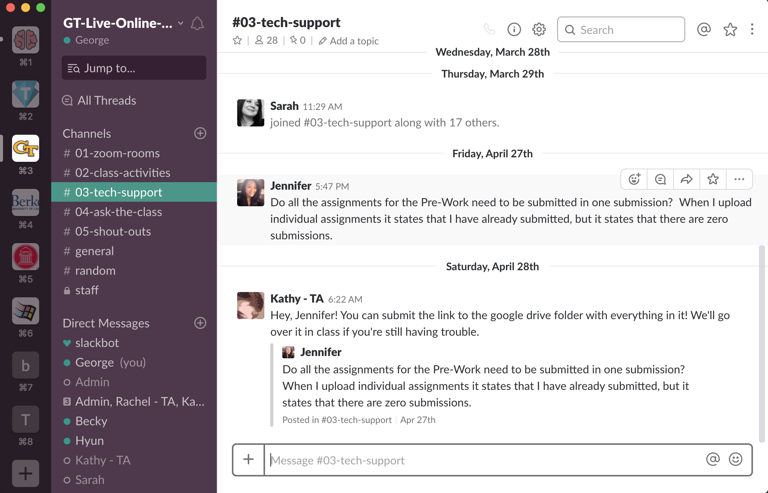
Slack Channels
#03-tech-support

Slide 25
#03-tech-support
Technical difficulties? Post in #03-tech-support!
Your instructional staff & classmates can help.

Slide 26
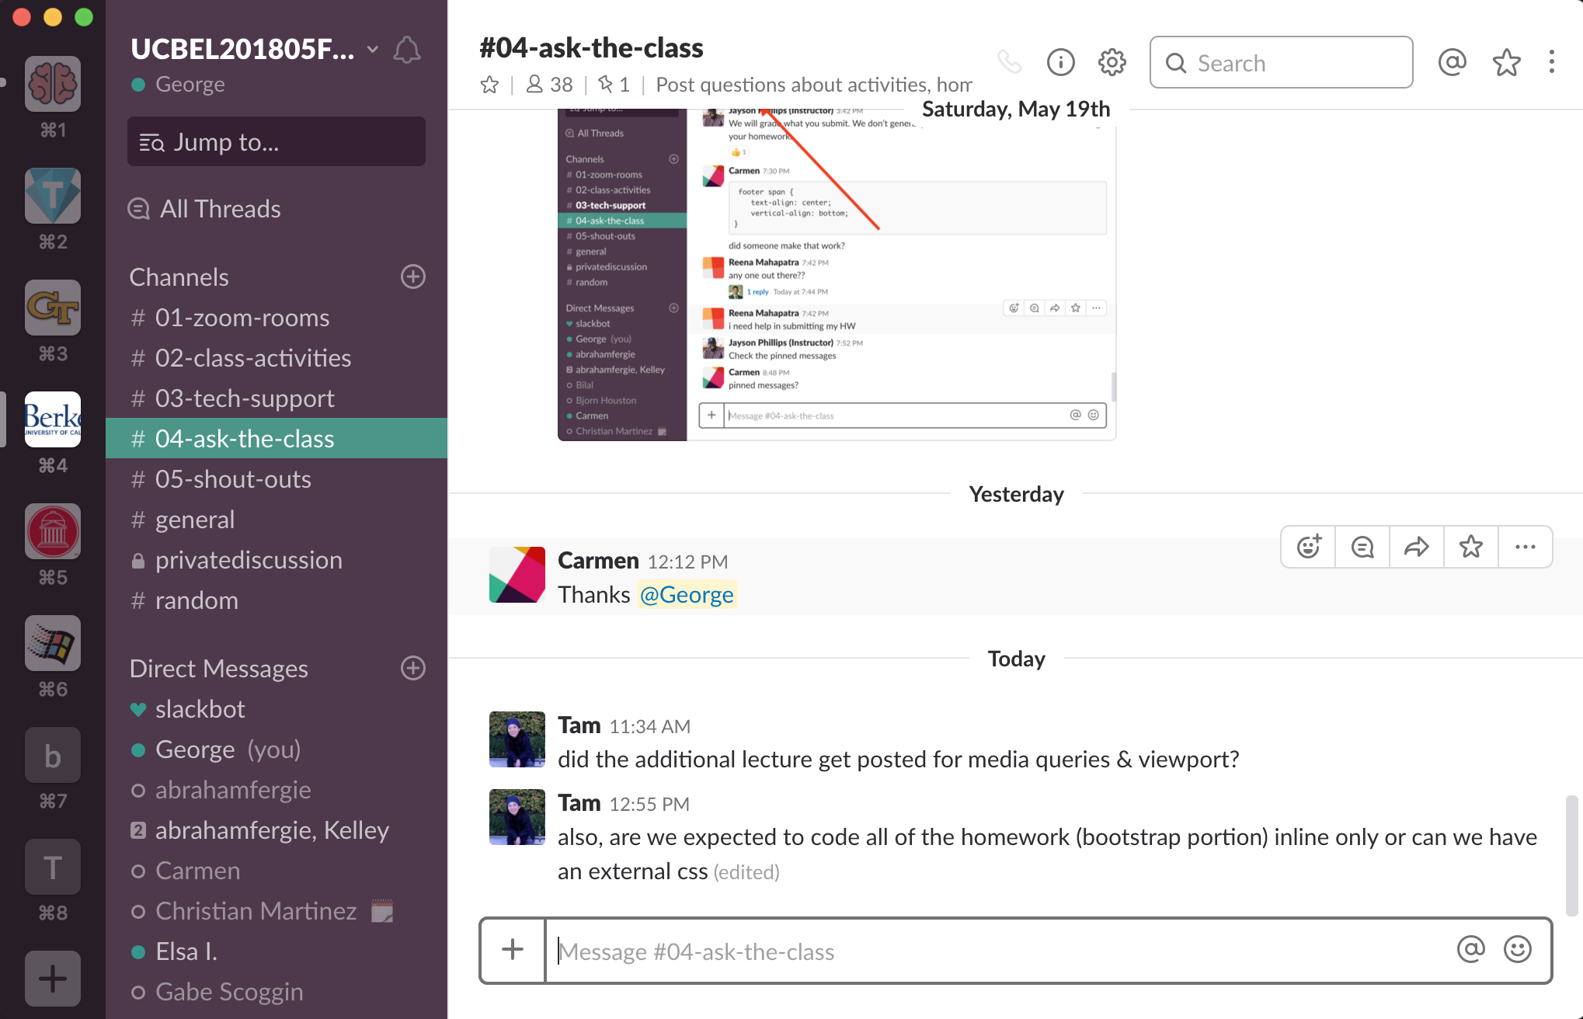
Slack Channels
#04-ask-the-class

Slide 27
#04-ask-the-class
Post questions about activities, homework, and projects in #04-ask-the-class.
Your instructional staff & classmates can help.

Slide 28
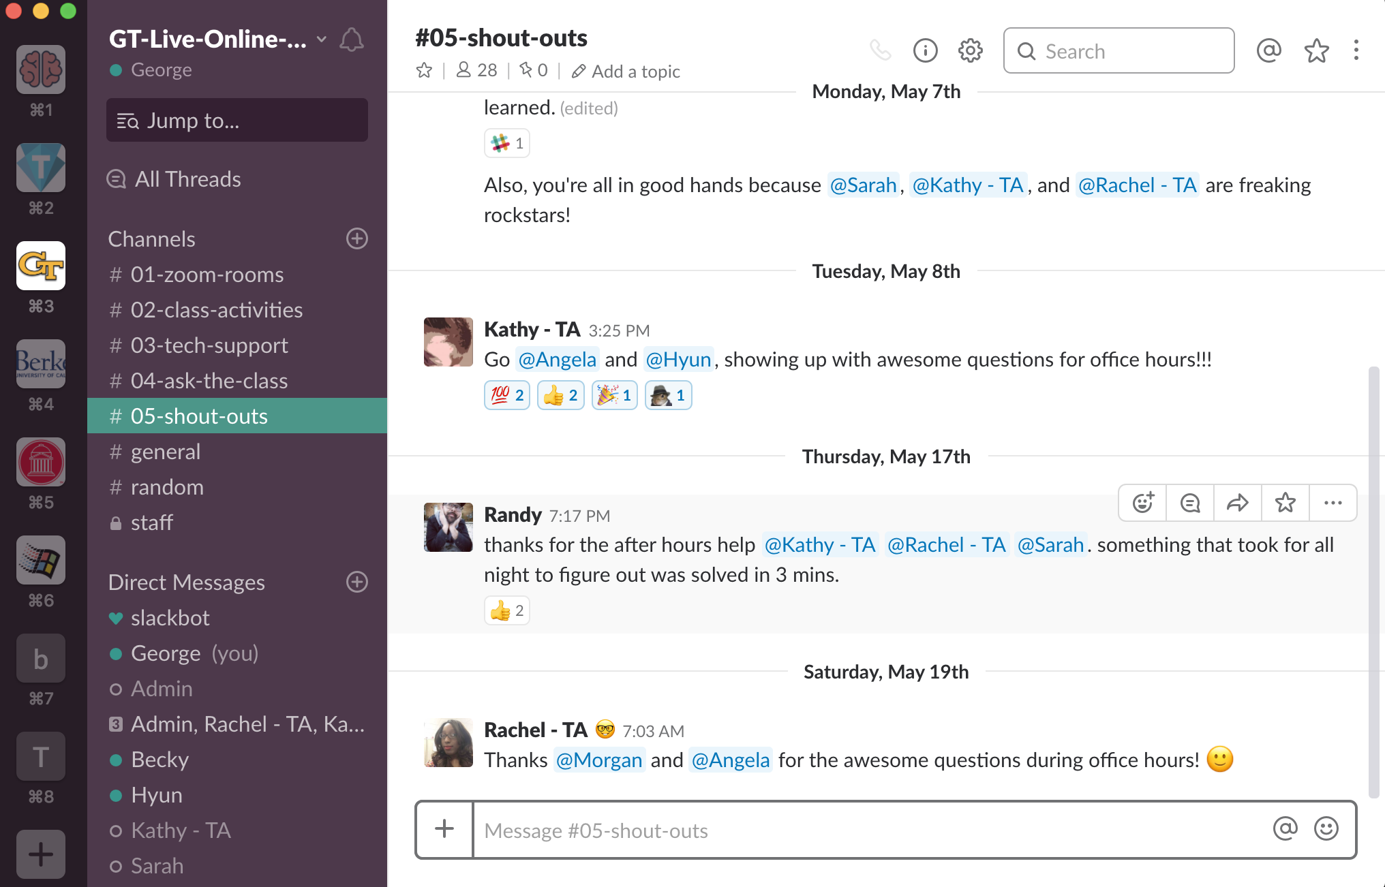
Slack Channels
#05-shout-outs

Slide 29
#05-shout-outs
Does someone deserve a virtual high five?
Post it in #05-shout-outs so we can celebrate each other.

Slide 30
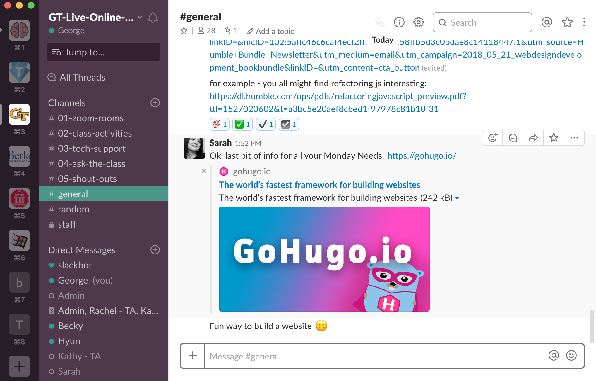
Slack Channels
#general

Slide 31
#general
General class announcements are posted in #general.

Slide 32
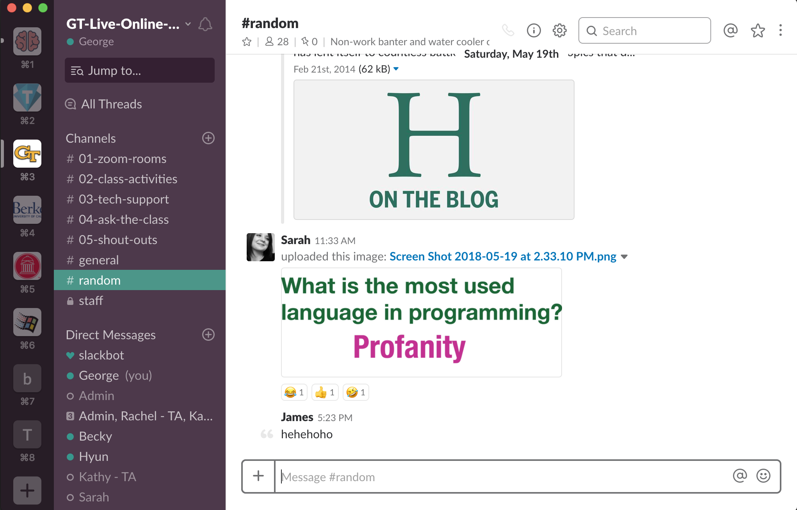
Slack Channels
#random

Slide 33
#random
#random...Just like it sounds...

Slide 34
Last, but not least...
Add your real name, and picture to Slack, it will help everyone start memorizing each other’s names and faces!
Notes:
Take a few minutes to allow students to update their slack profiles!

Slide 35
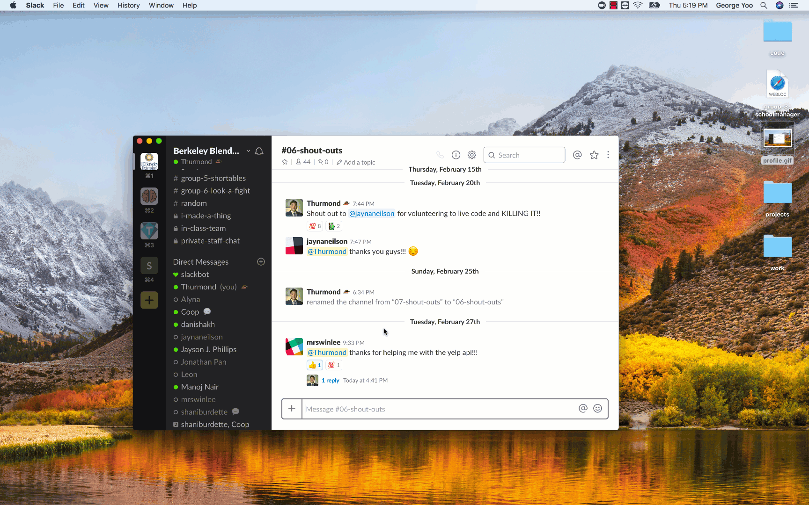
Slack Profile

Slide 36
Zoom

Slide 37
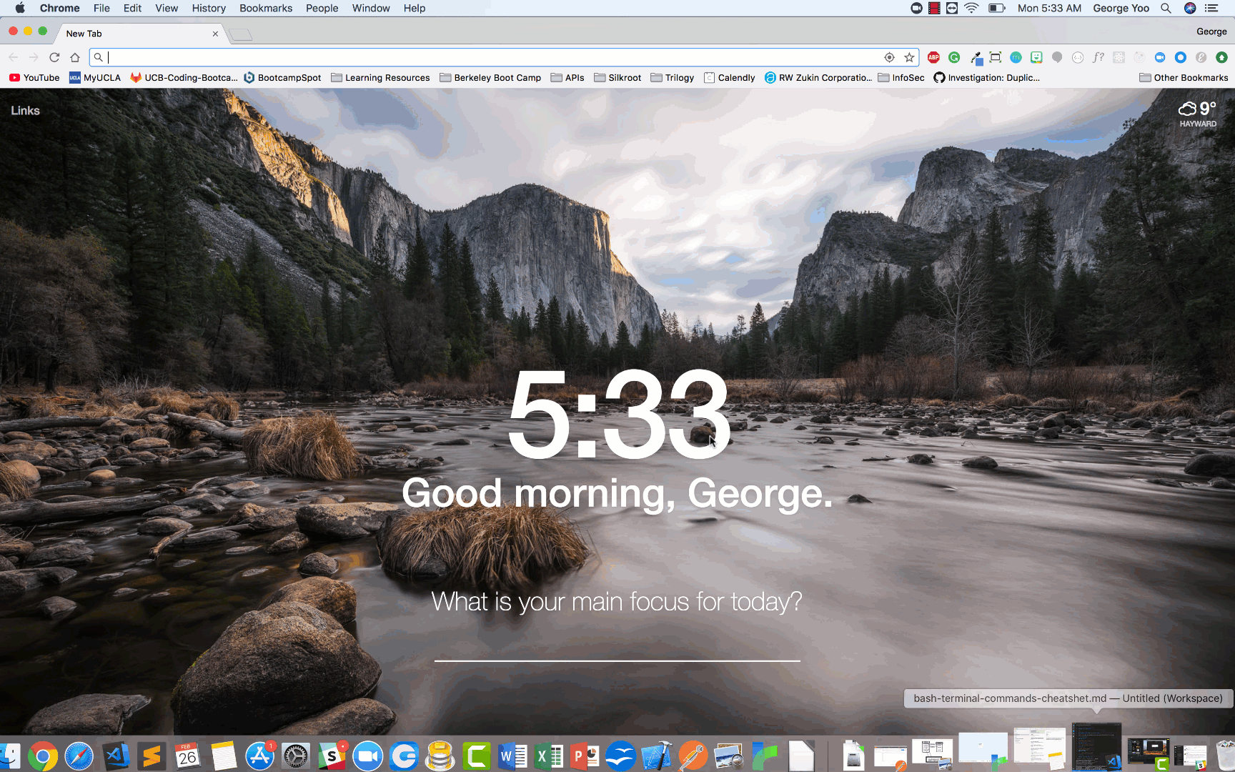
Sign up for a personal Zoom account at Zoom.us

Slide 38
Sign up for a personal Zoom account at Zoom.us
You can use your personal ID to meet with classmates outside of class hours (40 min max)

Slide 39
Zoom Client Settings

Slide 40
Zoom Client Settings
Make sure you’re logged into your new zoom account!
Next, click “Zoom -> Preferences”

Slide 41
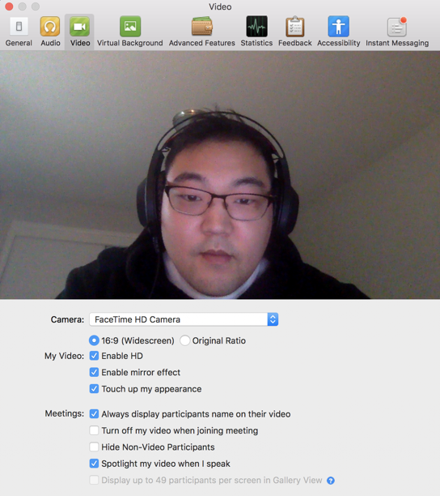
Zoom Client Settings
Video tab: Check "Always display participants name on their video"

Slide 42
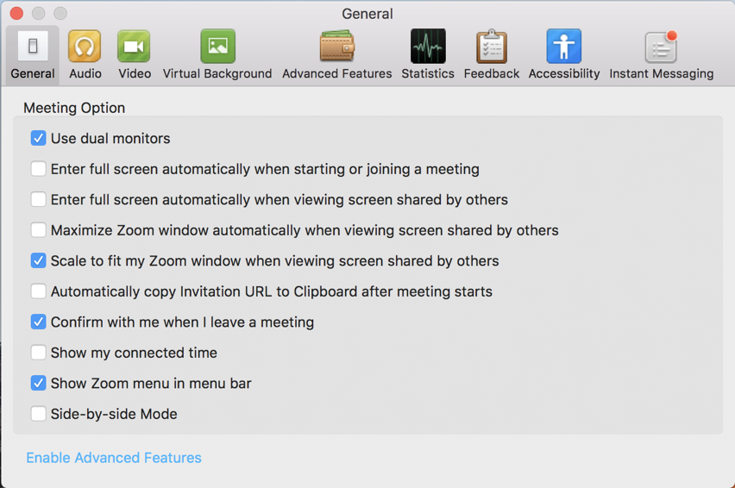
Zoom Client Settings
General:
- Check "Use Dual Monitors" and
- Uncheck “Full screen auto upon entering meeting”

Slide 43
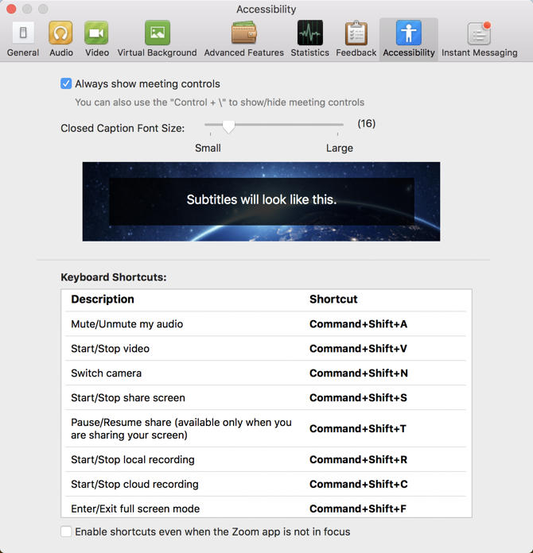
Zoom Client Settings
Accessibility: Check “Always show meeting controls”

Slide 44
Features

Slide 45
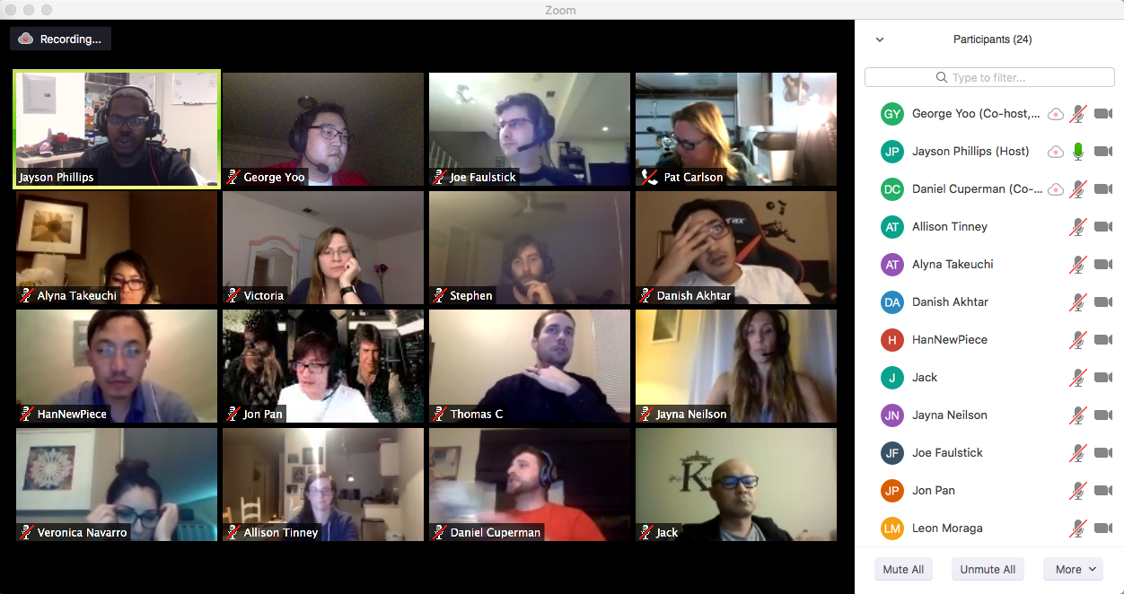
Use Gallery View to see all your classmates!
Notes:
The “Gallery” and “Speaker” views toggle button is located at the top right of the Zoom screen.

Slide 46
Use Gallery View to see all your classmates!
Try it! Switch between “Speaker View” and “Gallery View” on Zoom!

Slide 47
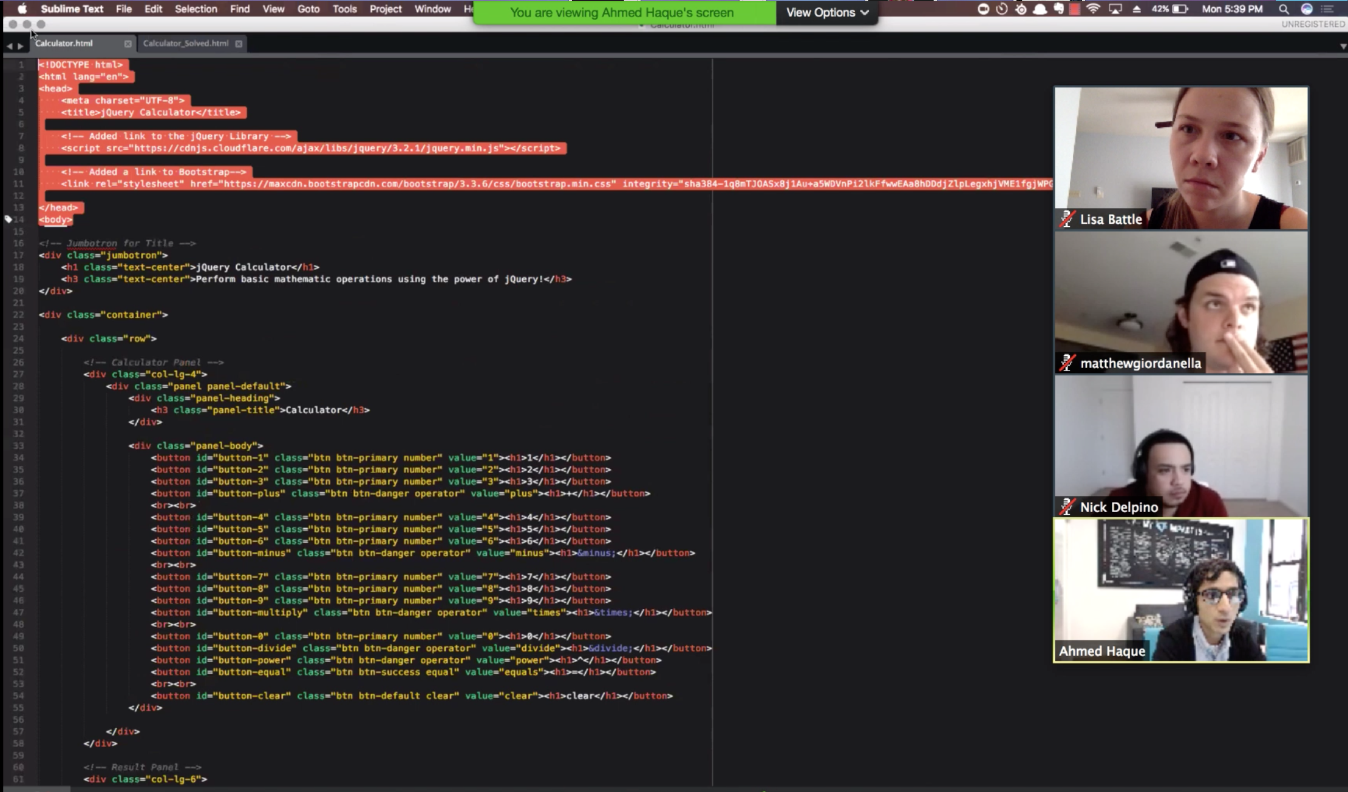
Instructor shares screen during lecture

Slide 48
Instructor shares screen during lecture
Move the Participants tab to your other monitor to avoid covering the shared screen!

Slide 49
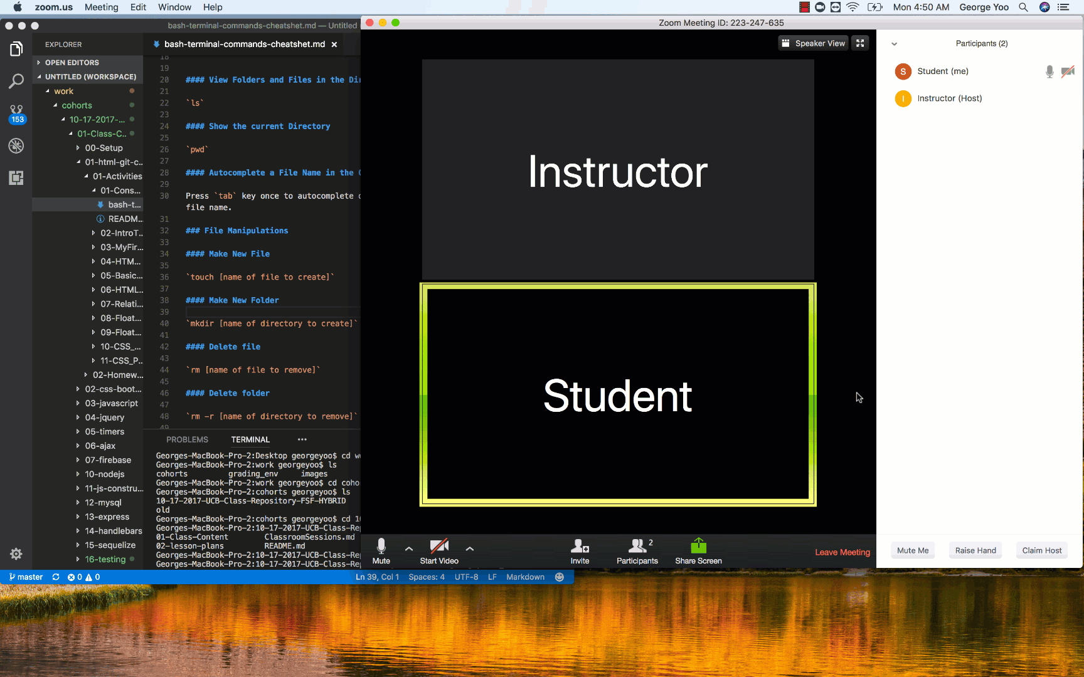
Students can share while asking / answering questions

Slide 50
Students can share while asking / answering questions
Try it! Share your screen with the class!

Slide 51
Moving to group zoom room for activities
For group activities, you will receive a prompt to move into your breakout room.

Slide 52
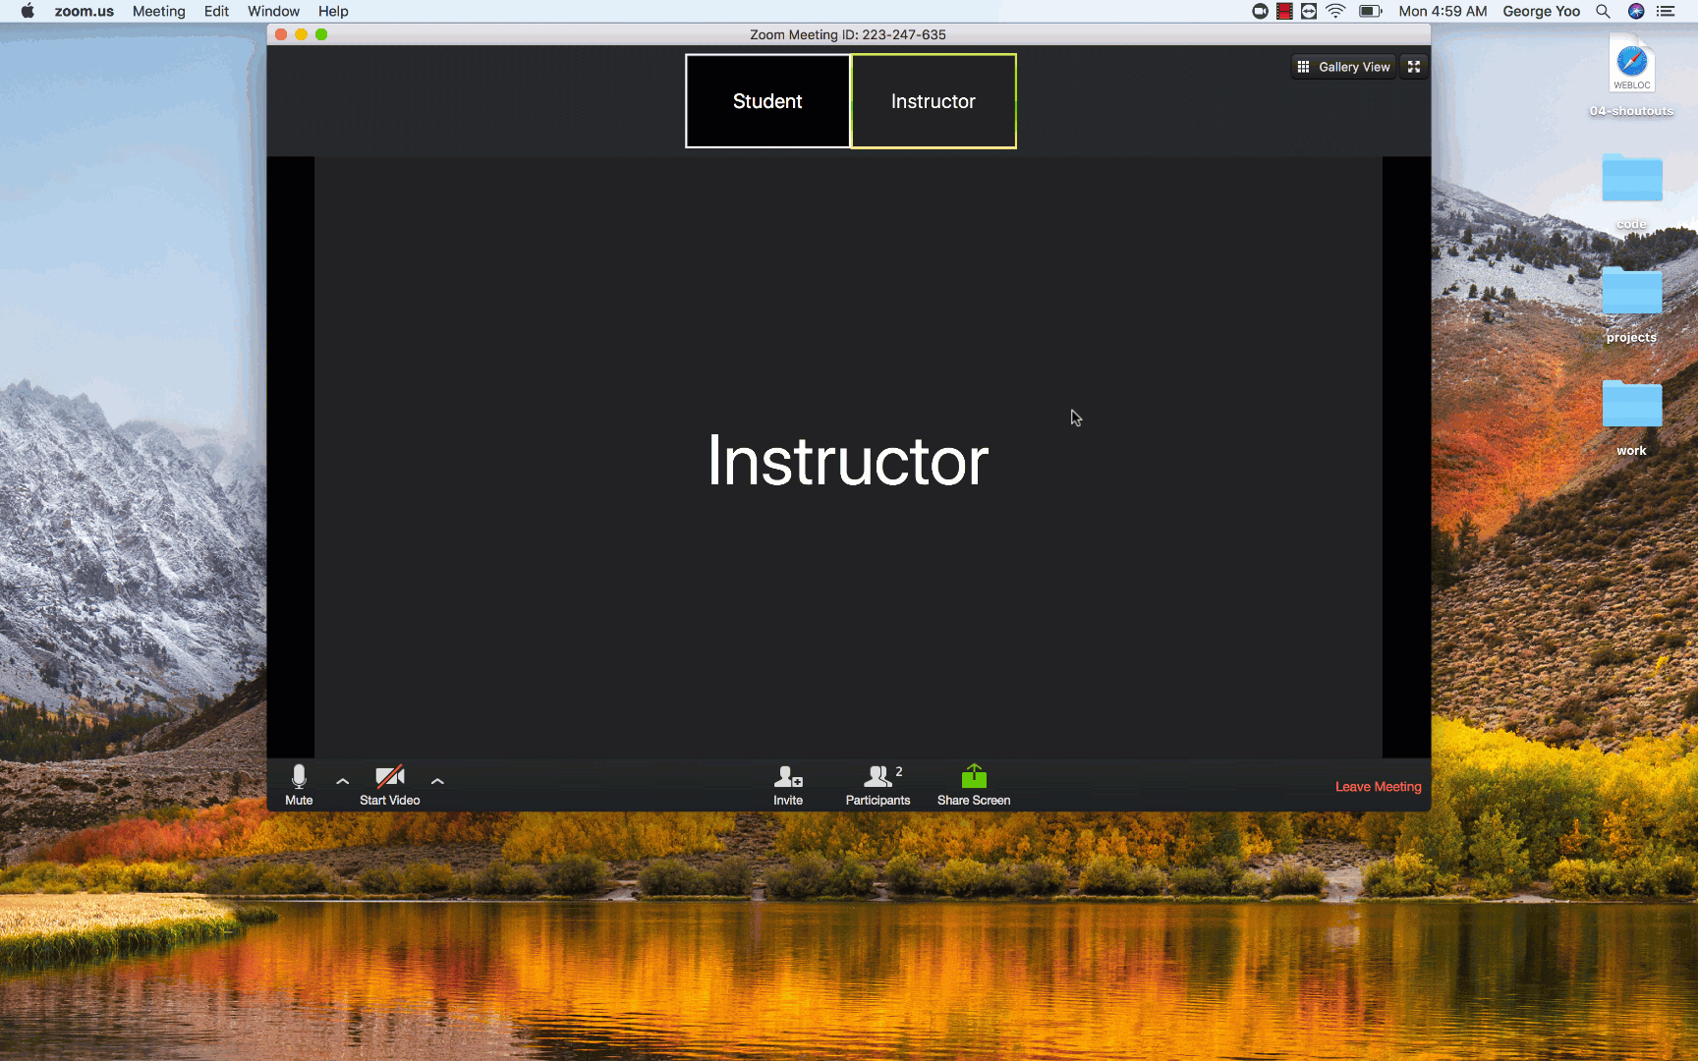
Moving to group zoom room for activities

Slide 53
Moving to group zoom room for activities
Join your breakout rooms when the prompt shows up!
Say “Hi” to your group mates and I’ll bring everyone back!

Slide 54
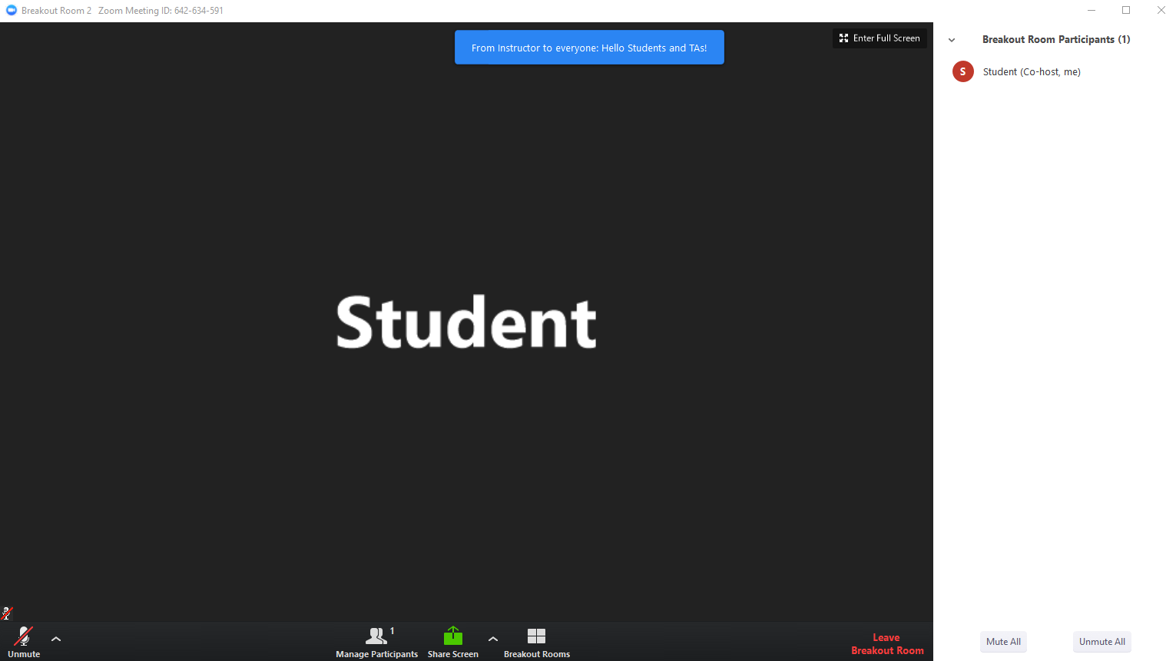
Broadcast Messages
Be on the lookout for Broadcast Messages from the instructor while in breakout rooms!

Slide 55
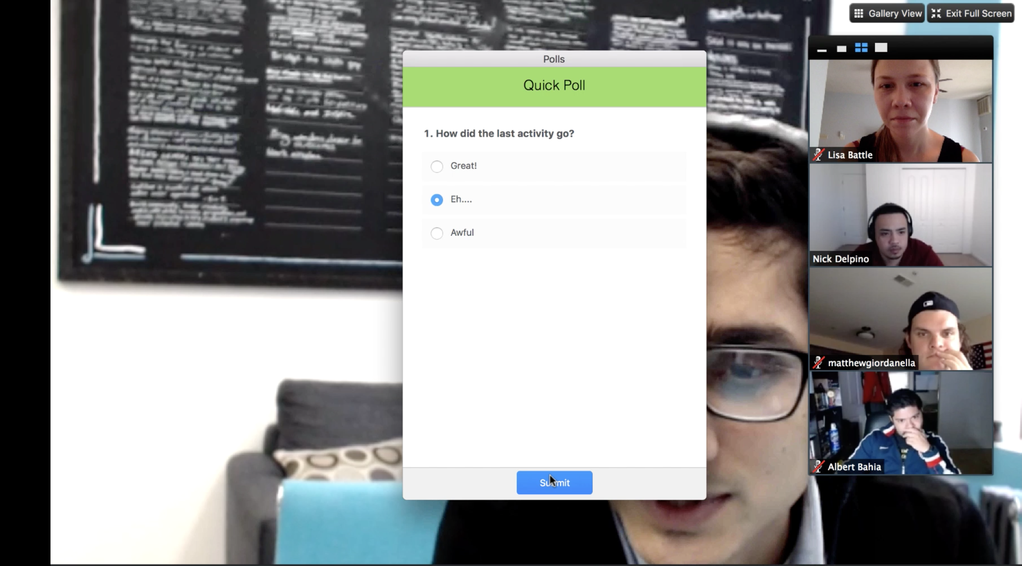
Anonymous Polls: How was that last activity?

Slide 56
Anonymous Polls: How was that last activity?
Let’s practice!
Take this poll to see how we’re doing so far!

Slide 57
Visual Studio Code

Slide 58
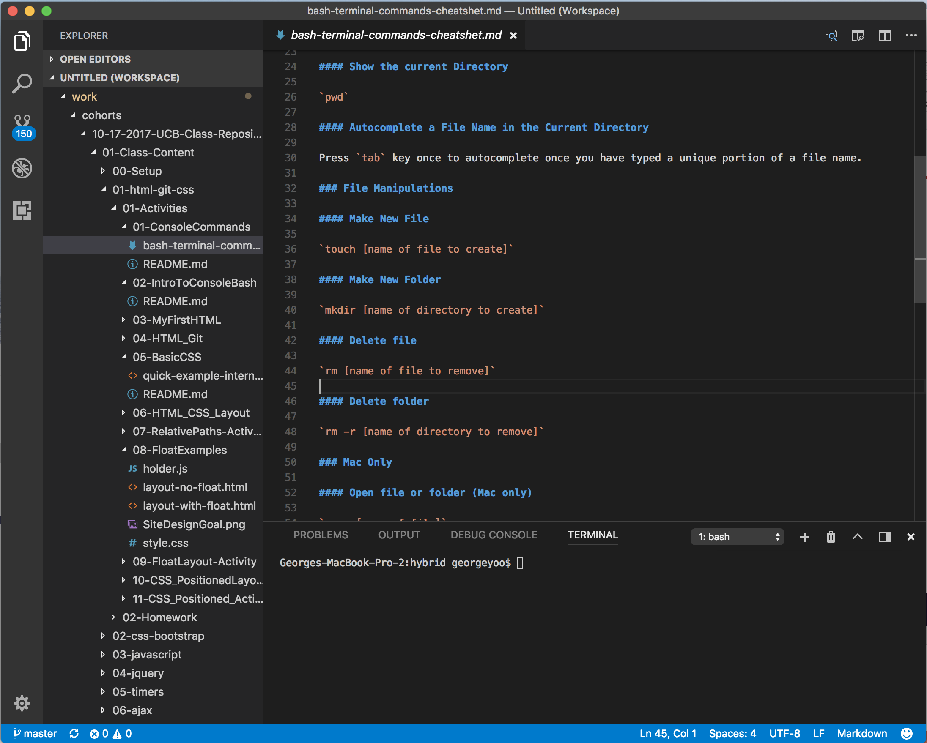
Pre-work should have asked you to install VS Code
Visual Studio Code is an editor for our code
Notes:
Change image to VS Code

Slide 59
VS Code Installation Check
Notes:
Take a few minutes downloading and installing Visual Studio Code!

Slide 60
Get Your Screens Right...

Slide 61
Get Your Screens Right...
Before every class:
Open Slack
Open Zoom Main Room
Open Bootcampspot, mark attendance
Open VS Code, get ready to learn!

Slide 62
Get Your Screens Right...
Screen 1 (Projector):
Zoom
Screen 2 (Workspace):
Slack
VS Code
Bootcampspot

Slide 63
Break Time!

Slide 64
Let’s Get into the Pre-work!

Slide 65
Questions?

